Slide 1
2.4 Periodic Trends
When the elements are arranged on the Periodic Table, certain characteristics of atoms show trends within the groups and periods.
These trends are observed as a gradual increase or decrease in the value of these characteristics.

Slide 2
2.4 Periodic Trends
The trending of these characteristics is dependent on two properties of atoms:
The highest energy level that contains electrons
  = each period adds another energy level around the nucleus
The number of protons and electrons in the atom
= the more protons and electrons in the atom, the stronger the attractive force

Slide 3
2.4 Periodic Trends
There are 4 characteristics of atoms
that we will study trends for:
Atom Size
Ionization Energy
Ion size
Electronegativity

Slide 4
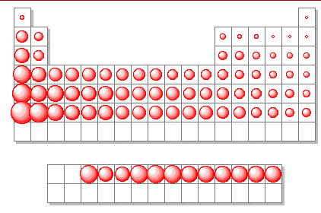
Trend #1 – Atomic Radius

Slide 5
Trend #1 – Atomic Radius
Going Down a Group
Why do atoms get bigger going down a group?

Slide 6
Trend #1 – Atomic Radius
Going Down a Group
Why do atoms get bigger going down a group?
Each period down adds another energy level around the nucleus, increasing the size of the atom

Slide 7
Trend #1 – Atomic Radius
Going Down a Group
Why do atoms get bigger going down a group?
Each period down adds another energy level around the nucleus, increasing the size of the atom
Going Across a Period
Why do atoms get smaller going left to right across a period?

Slide 8
Trend #1 – Atomic Radius
Going Down a Group
Why do atoms get bigger going down a group?
Each period down adds another energy level around the nucleus, increasing the size of the atom
Going Across a Period
Why do atoms get smaller going left to right across a period?
The number of protons increases moving across a period, increasing the attraction between the nucleus and the electrons. This attraction shrinks the atom.

Slide 9
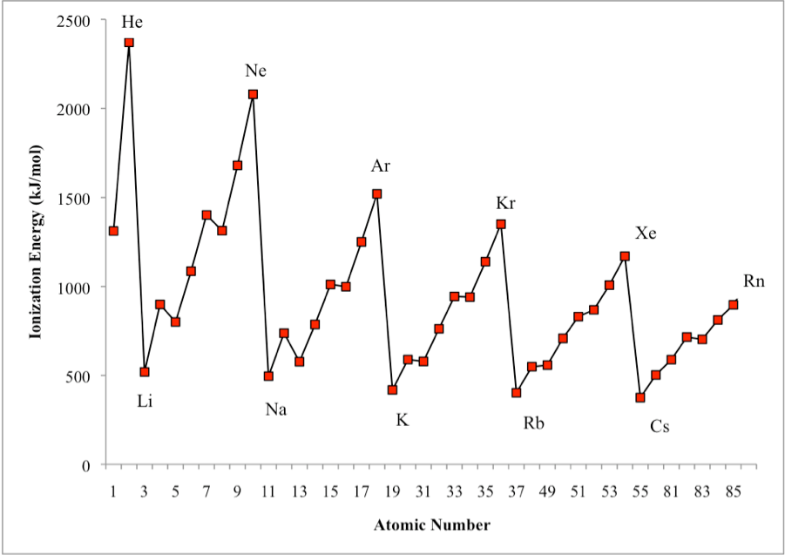
Trend #2 – Ionization Energy

Slide 10
Trend #2 – Ionization Energy
The higher the ionization energy for an atom, the harder it is to remove an electron from the atom.
The lower the ionization energy for an atom, the easier it is to remove an electron from that atom.

Slide 11
Trend #2 – Ionization Energy
Going Down a Group
Why is it easier to remove electrons from atoms further down a group?

Slide 12
Trend #2 – Ionization Energy
Going Down a Group
Why is it easier to remove electrons from atoms further down a group?
The atoms are larger and electrons are farther from the nucleus. This makes the electrons easier to remove.

Slide 13
Trend #2 – Ionization Energy
Going Down a Group
Why is it easier to remove electrons from atoms further down a group?
The atoms are larger and electrons are farther from the nucleus. This makes the electrons easier to remove.
Going Across a Period
Why is it harder to remove electrons as you move left to right across a period?

Slide 14
Trend #2 – Ionization Energy
Going Down a Group
Why is it easier to remove electrons from atoms further down a group?
The atoms are larger and electrons are farther from the nucleus. This makes the electrons easier to remove.
Going Across a Period
Why is it harder to remove electrons as you move left to right across a period?
The atoms are smaller moving right across the periodic table with electrons closer to the nucleus. This makes the electrons harder to remove.

Slide 15
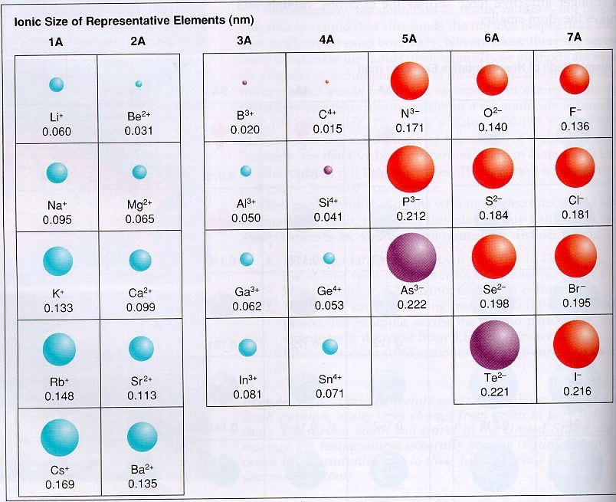
Trend #3 – Ion Size

Slide 16
Trend #3 – Ion Size
An ion is an atom that has lost or gained an electron(s).

Slide 17
Trend #3 – Ion Size
An ion is an atom that has lost or gained an electron(s).
Metals have low ionization energies and lose electrons easily. Metal ions are smaller than the original atom since they lost electrons.
Nonmetals have high ionization energies and gain electrons easily. Nonmetal ions are larger than the original atom since they gained electrons.

Slide 18
Trend #3 – Ion Size
Even though the size of ions increases when moving from metals to nonmetals across a period, the overall trend for both metals and nonmetals is a decrease in ionic size.

Slide 19
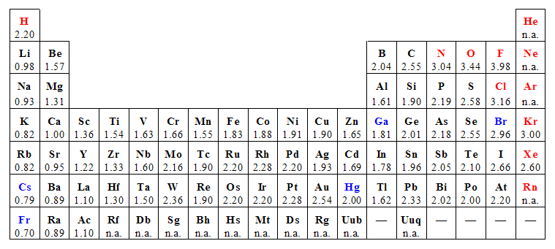
Trend #4 – Electronegativity

Slide 20
Trend #4 – Electronegativity
Going Down a Group
What is the trend for electronegativity going down a group?

Slide 21
Trend #4 – Electronegativity
Going Down a Group
What is the trend for electronegativity going down a group?
Electronegativity decreases moving down a group

Slide 22
Trend #4 – Electronegativity
Going Across a Period
What is the trend for electronegativity going right across a period?

Slide 23
Trend #4 – Electronegativity
Going Across a Period
What is the trend for electronegativity going right across a period?
Electronegativity increases moving left to right across a period.

